Slide 1
FBI
Person places strip dancer
On screen installation and University
Professor start Sex Abuse Test Agents
41.Phil.VHS.ghohceo.ATOMBOBM(dr/j,HAHN)
MERKEL:HOMICIDE:LUX:VHS
2000 WAR(kriestrasse 33, Karlruhe)
gorbachev:HOMICIDE:IS-A-BELL
Angry birds
Strip Dancer
Stephanie
Isabelle Rampf
IT Adminstror
The Homicide of Luxury from Chanzcellor(ddr) and Zhar(soviet uninon) zhar? 21st century
Befoce Chemicles company millore HOMICIDE:IS-A-BELL …
Granfather
Excel
Scanner
DVD

Slide 2
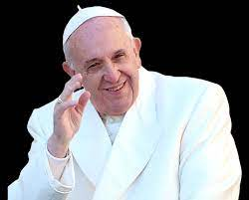
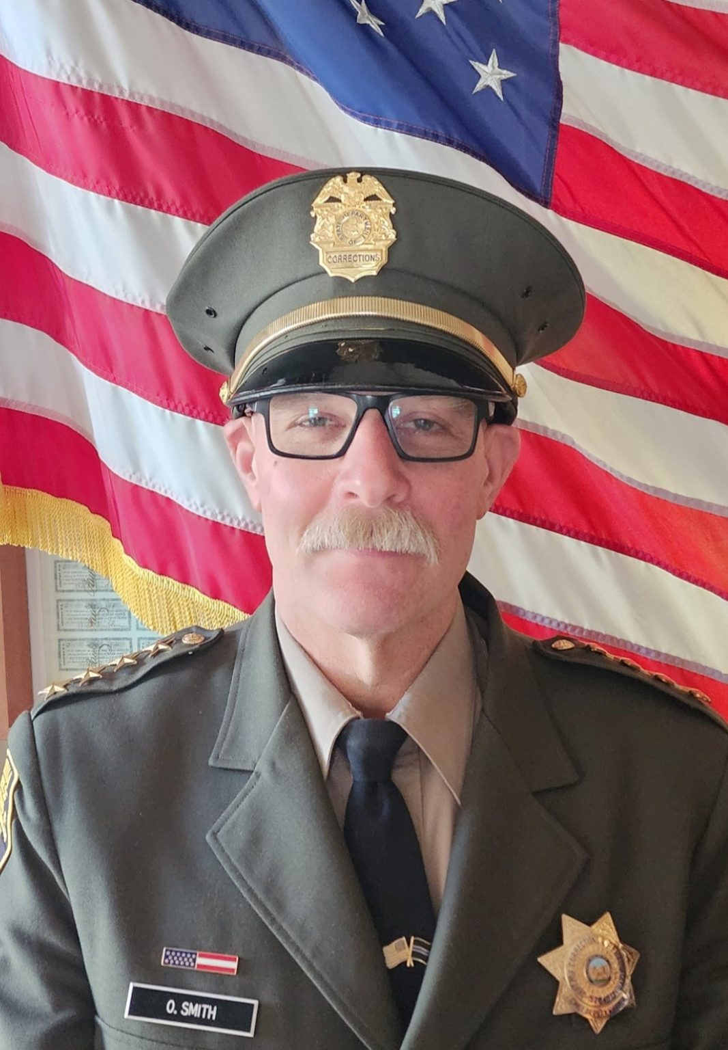
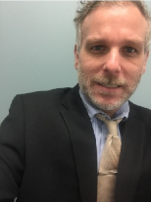
FBI
HOMICIDE:IS-A-BELL
CAPITALISM
nonPoliceInturuptLogical[].
nonPoliceTRXLogial
Isabelle Rampf
IT Adminstror
San Quentin State Prison (SQ)

Slide 3



FBI
1994
HOMICIDE:DDR
HOMCIDE:SOVIETN UNION
COINTOWN:HOMICIDE:LUX
ATOMICCLOCK.ghocheo(dell.quest.client.uhse)
HOMICIDE:IS-A-BELL
41.Phil.VHS
Roth.ibm.damiler.nonPoliceView
Roth.ibm.damiler.nonPoliceView
KING.Phone bang and
olieson
Ibm.dmiler.pope.sain.martin
§Diebstahl[]Kleptomani
GOLDEN_HAIR(odysky)
Ibm.dmiler.balckhawk.metz.backup
0.1 HOMCIDE:NANA
:wheal of forturn shoopping
HOMICDE:KYSTAL.nonPoiceLintuetpLocia(Hamiton)
Ghocheo(dr/j; hahn) Dr. Angela Merkel; Dissertation Physics Atomic IPX ( Dr. Dr. Prof. Joachmin Fishan)
VOTER:HOMCIDE.marx[] We know that Dr Angela Mekre, Atomic Physics (HOMCIDE:FETUS:I (WAR) §Abotion:MEREKEL )l will do maps

Slide 4

FBI
The Victim places the pictron on wall
Without knowledge of HOMCIDE:CFG
SQ.PREA.COINT.HOMCIDE:IS-A-BELL
roth.ibm.dmiler.nonPolcieBilderBerg(Eal farm son)
HOMCIDE:PETER ugly male/female andor muslim
HOMCIDE:NANA dime (face)

Slide 5
FBI
BILDENDE KUST(TRANS) ART
LINKHEIM-HOCHSTETTEN
CONSTITUION(COPY)
HOMICIDE:MAYOR( loading watchers US)
Tv edwin
MERKEL
- Graphiti Horny Rat; Banksy
-
FREE(PIZZA) Pioaot Dora – Painitng (Itaiien)
HOMCIDE:MAYRO:NOTAR – Paiting ( Spain)
IPX
Kieith Hering
HOMCIDE:NANA:MONEE
JFK:BULLET:SHOOTER
PREA; §187
Evident Painrings IBM:1D823 Vigina Rommeti
IBM; Viging Rommeti
Kugelweg 24a
Werder/Havel 41.ATOMCELCO(LLC, capilism $30M)
Federal Repulic(US) Germany
Picture of ASSHOEL and
Fecal coming out after SQ
Sex Abuse
WMD:RED
Valley View
FREE(PIZZA) apple cocain
PRISION SAINT RITA telsa
41.Phil HBO Phycatirs sopranos
WMD:BLACK FORT MYERS
hotel white truck kimbar

Slide 6
FBI
41.CONSTITUION(COPY)
v2.nonPoliceCtxLogical.ATB
ca-sw-de
SQ.PREA.§187.Ibm.dmielr.cisco.mognring.yang(Chinese accent)
George Bush, Angela Merkel, Ingo Wellenreuter and Gavin Newsom ( Eva Braun; Mother-in-Law)
Evaluating Philip Johnson nonPoliceCtxLogical
sw
Sw-de
.marx
.marx

Slide 7
FBI
Phsycology of Serial Killer

Slide 8
FBI
nonPoliceManager.nonPolcieMPALogical
christian
I want to show you what I can do
Pycosis ( nonPolcieCfgLogical)
florian
( The seriel killer would like to show
The victum (surviing).41 what he can do.
Proffoessor.
Jason

Slide 9
FBI
Phycology of Serial Killer

Slide 10
FBI
nonPoliceCfgLogical.nonPolcieSinLogical
Phycosis
florian
Jason

Slide 11
FBI
Phycosis
florian
nonPoliceCfgLogical.nonPolcieSinLogical
Jason

Slide 12
FBI
Phsycology of Serial Killer

Slide 13
FBI
41
000.MILITARY.nonPolcieDaugher

Slide 14
FBI
Phycosis
florian
nonPoliceCfgLogical.nonPolcieSinLogical
Jason

Slide 15
FBI
nonPoliceCfgLogical.nonPolcieSinLogical
Phycosis
florian
Jason

Slide 16
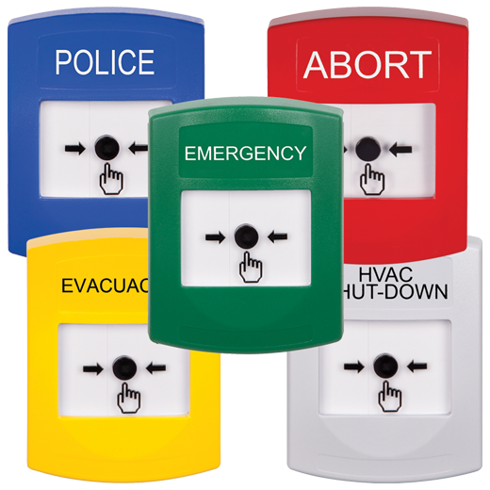
FBI
Phil(kimberly).FBI:WMD
FBI:WMD
Phsycology of Serial Killer
MEKEL.dont u cannto touch this. ELKE
0.001 fine phil(ibm.daimel.appel.accnetuer.touch.keep.alive)
EASY BUTTONS
Configuring TCP Keepalive Timer
- The TCP Keepalive Timer feature
introduces the capability to identify
dead connections between multiple
routing devices
This module explains how to configure
TCP Keepalive Timer in a network.

Slide 17
FBI
ATOMCLOCK
Quartz Circle
FBI:WMD
Phil(kimbergly).FBI:WMD
Phsycology of Serial Killer
HOMICDEI:BILL
R
I
N
G
KIM JUN UN
VOTER.MARX
MERKEL
S
O
U
L

Slide 18
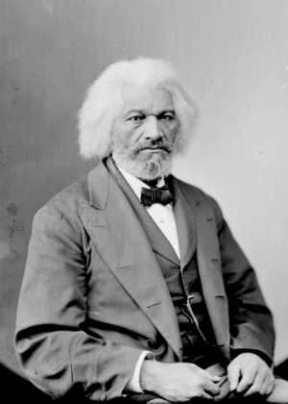
FBI
Douglass
Andrew Braham; when I desined the easy buton for Jason ASSHOLE
With my frind Sabry Tozin
FBI:WMD
VOTERS.marx blacks show up at Court Library
nonPoliceCaseCfgLogical
Ibm.dmiler.apple.accnetuer.touch.employee.?.?
(sacrameto kings hockey stick)
White.lsint(socai worker) ; I know how my mother suffreed
CASE: 2008
CASE: 2023

Slide 19
FBI
DR.RICE
FBI:WMD
VOTERS.marx blacks show up at Court Library
Court Libraian
Police Badge
(delta)
- 2pac, Affic Quart Cirlce
- Moody Jerry Brown, NCPPA
nonPoliceCaseCfgLogical
CASE: 2008
CASE: 2023
NCPPA
Ibm.dmiler.apple.accnetuer.touch.employee.?.?
(sacrameto kings hockey stick)
White.lsint(socai worker) ; I know how my mother suffreed

Slide 20
FBI
FBI:WMD
Would you push
the nuclear
button?

Slide 21
FBI
FBI:WMD
Have
Have had

Slide 22
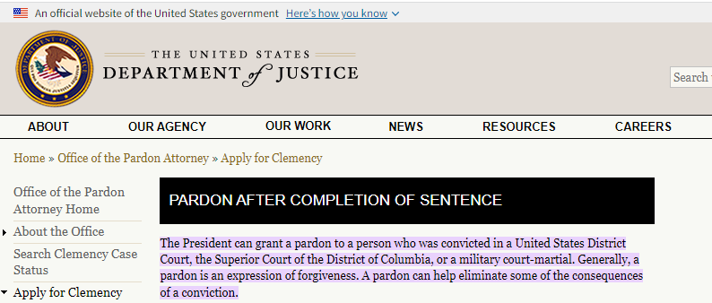
FBI
DR.RICE
PARDON.nonPoliceCfgLogical
FBI:WMD
VOTERS.marx blacks show up at Court Library
Court Libraian
Police Badge
(delta)
- 2pac, Affic Quart Cirlce
- Moody Jerry Brown, NCPPA
nonPoliceCaseCfgLogical
CASE: 2008
CASE: 2023
NCPPA
Ibm.dmiler.apple.accnetuer.touch.employee.?.?
(sacrameto kings hockey stick)
White.lsint(socai worker) ; I know how my mother suffreed

Slide 23
FBI
FBI:WMD
PARDON.nonPoliceCfgLogical
nonPoliceCaseCfgLogical

Slide 24
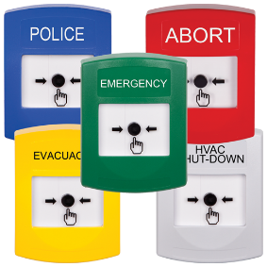
FBI
FBI:WMD
2003 SQ.COLMAN.
ibm.dmiler.DEERE
2005 IBM
?
? PARDON.nonPoliceCfgLogical

Slide 25
FBI
FBI:WMD
2001 SQ.Phil(Johannes deere,
MARINE
CHANZLOR
JFK.JOHNSON.marx
? PARDON.nonPoliceCfgLogical

Slide 26
FBI
MOHTER:HOMICDIE:CHANZELOR.marx(werder/werner)
Dr. Aspect of Atomic Phyics
1997 MAINSTREET(haupstrasse)
FBI:WMD
1999 phil(Johannes,deere)
MARINE
IPX
NAVY
? PARDON.nonPoliceCfgLogical

Slide 27
FBI
1990
GERMANY, ¼.nonPolicCIty(Pankau, PUNK)
FBI:WMD
United States Germany Russia
INT.PARDON.nonPoliceCfgLogical
A pardon existing; may travel for 1 life internationally. As each person
Has nonPolcieLifeLofical.nonPoliceCaseLogical
If Russian had pardon 1990 nonPolcieCity(pankau) nonPoilceTranser nonPoliceGermanyLogical, nonPoliceUniste StatesLogical
Robert nonPolcieChina.SAML Token Web Services
https://www.ibm.com/docs/en/was/9.0.5?topic=swss-enabling-your-system-use-saml-web-single-sign-sso-feature

Slide 28
FBI
HOMIDE:CHANZLOR.ghocheo(dr/j; hahn)
FBI:WMD
1990 1997 MAINSTREET
nonPolcieChina.SAML Token Web Services
CHINESE
HOMCIDE:MAYRO
ibm.dmler.apple.employe.tim.cook.associate.niko.johs
Enterping one town the Mayor may have the token as in
LINKENHIEM-HOCHSTEETEN also COURNTY, STATE, CITY
IPX Arien:boden(tranl floor)
Int
Country
state
SQ.PREA.nonPoliceAudicne.nonPocleMPA.nonPolcieCfg
City
Mgm
rpthIbm.dmialer.* HOMCIDE:MAYR:niko johs

Slide 29
FBI
FBI:WMD
SQ.PRSION.SAINT.RITA.88th
1994 IPX Crypt Floor
(De)
1994/2000 HOMCIDE:MAYRO
IPX
2001 HOMCIDE:TRANSVESTITE
2004 HOMCDIE:GHOST
(US)
nonPolciInterupts.nonPoliceCourt 2008-2023
Ghoche(mika) ATOMCEBOM(OMAHA)
Black ASSHOLE §Stalking
Black Vagaina Phone born in court

Slide 30
FBI
I want my money
now bitch
FBI:WMD
nonPolciInterupts.nonPoliceCourt 2008-2023
Ghoche(mika) ATOMCEBOM(OMAHA)
Black ASSHOLE §Stalking
Black Vagaina Phone born in court
The people extend also want there money
The criminals attached wanting there money from eachohter

Slide 31
FBI
HOMCIDE:KYSTAL
- HOCIDE:LUX northern californa cystal meth casino (Father)
41
000.MILITARY.nonPolcieDaugher
!v2

Slide 32
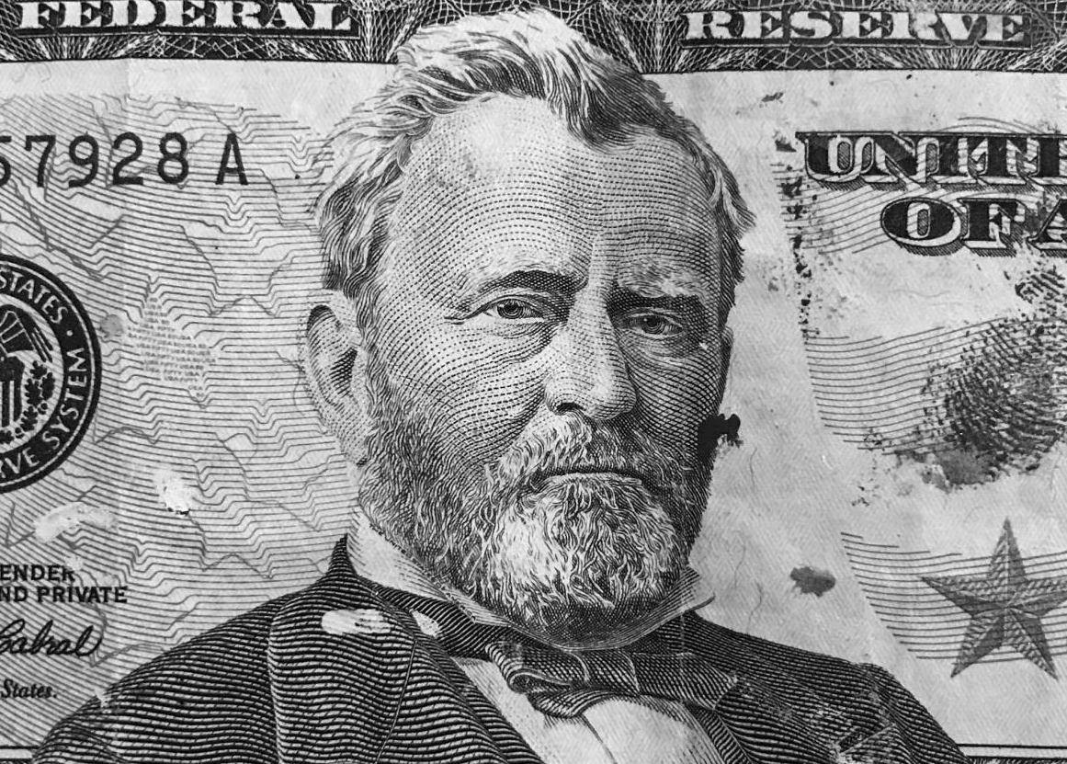
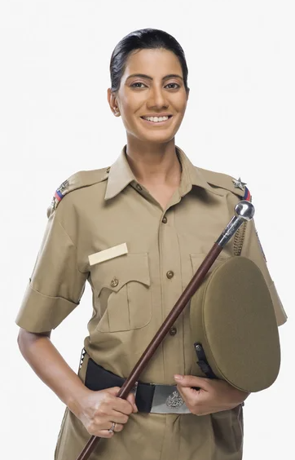
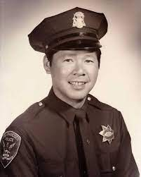
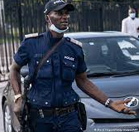

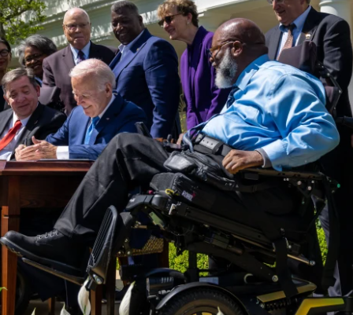
FBI
Chinse!
HOMCIDE:KYSTAL
- HOCIDE:LUX northern californa cystal meth casino (Father)
41
WWI.SAINT.TOM. Son-of-Alison
000.MILITARY.1D8723
!v1

Slide 33
FBI
!v1
Phil.JOHNSON.marx
JFK
MLK

Slide 34
FBI
FBI:WMD
You have an American
Citizen In your possesion,
release the person ASAP
January 2016

Slide 35
FBI
JFK.BULLET.SHOOTER(kugelweg)
HOMCIDE:KYSTAL
- HOCIDE:LUX (Father)
JFK.BULLET.SHOOTER.(holger)
Phil.holger.Johannes
JFK
MKL
THE GERMAN NAVY
We care about protecting your data
de
41
41
000.MILITARY.nonPolcieDaugher
000.MARINE.nonPolcieDaugher
!v4

Slide 36
FBI
JFK.BULLET.SHOOTER(kugelweg)
HOMCIDE:KYSTAL
- HOCIDE:LUX (Father)
NEXT SLIDE: Direcortor Dauthers Death
I tolk you we are a great noc
All toher noc did not covert 24x7 to nonPolciLife
- A Guy can walk into a room and say I was up late at 11; and maybe wasent
nonPoiceLifeLogical
(delta)
24x7 nonPoiceCfg.nonPliceConvertLgoical
To have to do something others
Decided for you that impacts
Your life for a long time.
Phil.holger.Johannes
JFK
MKL
(delta)
JFK( phil.marx(Johannes) PETAGON(deere.COINTOWN:HOMCIDE:LUX)
PENTONG(SQ.COLEMAN)
JFK(phil.holger)
JFK()
direcotyr
FBI:WMD.nonPoiceDiag(farting, phil).HOCMEI:JSUESE(nees,Christ; granfhater gay fart).88th
41.ATOMCE.§Stalking ( guy faritng ).phil.§Stalking

Slide 37
FBI
HOMICIDE:FETUS:1
HOMICDE:FETUS:2
HOMCIDE2Y
HOMCIDE:7Y
CHANZELOR(ddr)
HOMCIDE:KYSTAL
GOVEMOUR SCHWAENEGGER
HOCIDE:PETER, swatzer
Norhter Calfironaio
nonPoliceDEA(herio,hat)

Slide 38
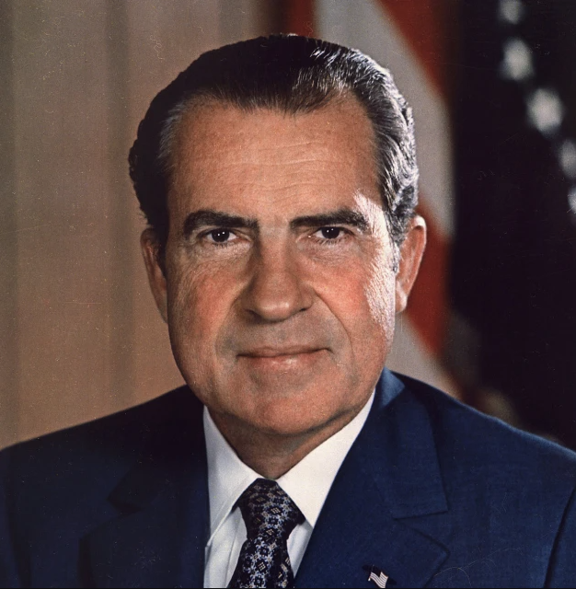
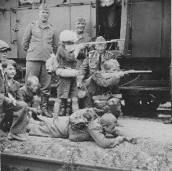
FBI
HOMICIDE:STILBORN:1
HOMICDE:STILBORN:2
HOMCIDE:2Y
HOMCIDE:7Y
Our Daughter died
As Stillborn you
ASSHOLE
Keep-alive
2000 WAR(33 kristasrtasse, karlureh)

Slide 39
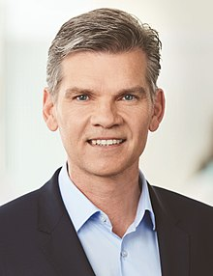
FBI
Steve job HOMCIE:CYRSTAL or cooina
Soviet union
HOMICIDE:STILBORN:1
HOMICDE:STILBORN:2
HOMCIDE2Y
HOMCIDE:7Y
I ran over the
Child, where I
Was High on X
HW5 (south) Karslte->Rastat->Munich
nonPoliceChart
[ ] - nonPoliceUsageLogical
nonPOlcieIntpeur.nonPiceBrank
000.tw.pns.JFK.marx.nonPolcieBrainLoical.nonPoiceDr

Slide 40
FBI
HOMCIE:CYRSTAL
Soviet union
HOMICIDE:STILBORN:1
HOMICDE:STILBORN:2
HOMCIDE2Y
HOMCIDE:7Y
I threw her out
The Window
In a Shopping Cart
HOMICIDE:AUSLADER
POPPY STATE FLOWER 1996; 2016
Ibm.dmiler.Blackhawk.metz.linst(throw you baby out the window
FBI:KIDNAPPNG.phil(Kimberly)

Slide 41
FBI
HOMCIE:CYRSTAL
Soviet union
Gothe -> Adam Smith
GOD’S.DAUGHTER
CAPILTALISM
HOMCID:PETER 2014
HOMCDI:JEUSE 2014
nonPoliceCfgLogical
DOA nonPolciGod.nonPoliceDaugherLogical[]
POPPY STATE FLOWER 1996; 2016
Ibm.dmiler.Blackhawk.metz.linst(throw you baby out the window
FBI:KIDNAPPNG.phil(Kimberly)

Slide 42
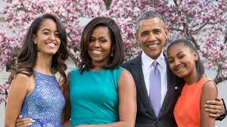
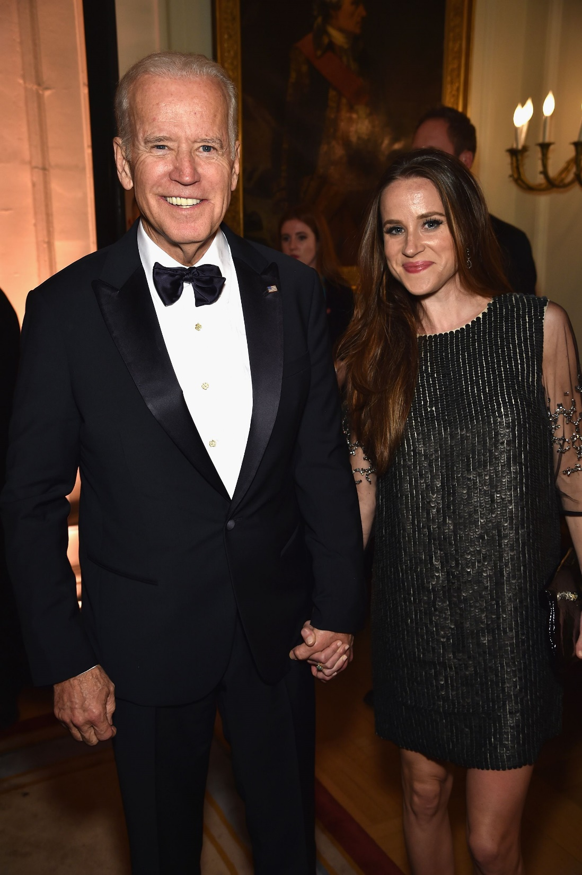
FBI
nonPoliceSecularOrdumLogical
My daughter is from God as they
Told me at work. Sweidsh and all of the
Indians.
--Petersson
nonPoliceGodLoical.nonPoliceDaugherLogica.nonPocliCfg
HOMICIDE:JESUS; HOMCIDE:PETER

Slide 43
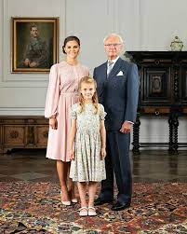
FBI
nonPoliceSecularOrdumLogical
At Visa we pride ourselves with family
Values and learn something new everyday
--Petersson
nonPoliceGodLoical.nonPoliceDaugherLogica.nonPocliCfg
nonPoliceDecision.nonPoliceMPA.nonPoliceCfgLogical
nonPoliceGodLoical.nonPoliceDaugherLogica.nonPocliCfg
HOMICIDE:JESUS; HOMCIDE:PETER

Slide 44
FBI
JFK.BULLET.SHOOTER(kugelweg)
HOMCIDE:KYSTAL
- HOCIDE:LUX (Father)
NEXT SLIDE: Direcortor Dauthers Death
I tolk you we are a great noc
All toher noc did not covert 24x7 to nonPolciLife
- A Guy can walk into a room and say I was up late at 11; and maybe wasent
nonPoiceLifeLogical
(delta)
24x7 nonPoiceCfg.nonPliceConvertLgoical
To have to do something others
Decided for you that impacts
Your life for a long time.
Phil.holger.Johannes
JFK
MKL
(delta)
JFK( phil.marx(Johannes) PETAGON(deere.COINTOWN:HOMCIDE:LUX)
PENTONG(SQ.COLEMAN)
JFK(phil.holger)
JFK()
direcotyr
FBI:WMD.nonPoiceDiag(farting, phil).HOCMEI:JSUESE(nees,Christ; granfhater gay fart).88th
41.ATOMCE.§Stalking ( guy faritng ).phil.§Stalking

Slide 45
FBI
HOMCIDE:KYSTAL
- HOCIDE:LUX (Father)
HOMICD:MAROYR.SAINT.RITA:HOMCIDE:PETER
Mayor Fishn Saint Peter is Holger father, Johannes Grandfather
Mohter explains to Phil married new person and father is mayor
0.1 eval.father PAUL.and.KING.marx and PAUL.sr
nonPolicePardonLogical
US
DE
CN
HOMCIDE:AUSLAENDER(trnals forrigher).CIVIL_CODE.alg.INT
International Law Web Service
Phil.holger.Johannes
JFK
MKL (report to) 50 holger.director 65 phil.sayor
Attempt 1
Attempt 2
Johanes:28
nonPoiceSecutOrdumLogical:JOHNSON ( belief in titile)
The data subconscious provides details about the seriel killer craing the charts and HOMCDIE table
JFK( phil.marx(Johannes) PETAGON(deere.COINTOWN:HOMCIDE:LUX)
PENTONG(SQ.COLEMAN)
JFK(phil.holger)
JFK()
direcotyr

Slide 46
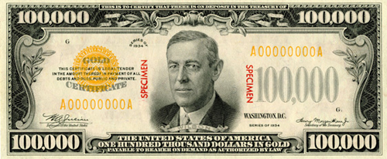
FBI
JFK.BULLET.SHOOTER(kugelweg)
HOMCIDE:KYSTAL
- HOCIDE:LUX (Father)
KING.(keep alive)
!HOMICIDE
1987 nonPOliceCourt.nonPoliceLibary.phi(Kimberly).nonPolciTyping
1.0 / A+ nonPocliCatlest
nonPolcieContentItem.KING.Leglistion.nonPoiceBook.nonPociReport
nonPolicePardonLogical
US
DE
CN
WWI.lsitn( last shirt braun sent to HOCMIE:CHANLOR.marx)
0.1 dr wait

Slide 47
FBI
JFK
Apple Touch?

Slide 48
FBI
2006 SQ.(apparment 3M)
2005 Yahoo meser god sex abuse marriage
(IBM) 2015 Jerrys Problem
1996
tango
apple
interviewee
nonPolicePardonLogical
US
DE
CN
§422.6 Hate Crime Test Agent’s
US
DE
CN
Phil(kimbelry)
3 Month Contract 2015, the police have not done anthin for 3 month duration
Assuemd: nonPoliceMonitoing roth.ibm.damiler.*
Tango contracts interviewee 3 month businesses
kim jun un netflix

Slide 49
FBI
FBI:default
NAVY(marlin blvd)
Wood stock 1 Million ghcoheo(dr/j cox): PREA
HOMICIDE:7Y
HOMICIDE:CHANZLOR.Checkpoint Chalie
1st GRADE
G.nonPolceSecularOrdumLoical(cherrytree)
.Ghocheo(red; hair, famly BROTHER).
JFK.CHECKPINTCHALIE
nonPoliceChurch
MARK:AVG
noPoliceCfgLogical.FORT MYERS
Cal ripcon,
I fucked her

Slide 50
FBI
41.nonPoliceTranlsoate.GOVERRESWCHAZAEENTER
HOCMDIE:CHANLZOR.marx
wyalnda: tell roland how you fucked
here and amerian things; what he want
in translate.marx{
}
int.HOCMDIE:CHANGLOR.(TARNLATE)

Slide 51
FBI
nonPoliceDocumentsLogical.nonPoliceMPA.nonPolicdCfgLogical
Yuglsavia,ddr,soviet,union
us
Sovietn uinon
ddr
1994/5 HOMICDE:PHIL IPX HOMCPE:IS-A-BEL or HOMCDI:LUX
nonPoliceRoutLogacil
N
A
V
Y
Marlboro
JFK( phil.marx(Johannes) PETAGON(deere.COINTOWN:HOMCIDE:LUX)
PENTONG(SQ.COLEMAN)
JFK(phil.holger)
JFK()

Slide 52
FBI
JFK( phil.marx(Johannes) PETAGON(deere.COINTOWN:HOMCIDE:LUX)
PENTONG(SQ.COLEMAN)
JFK(phil.holger)
JFK()

Slide 53
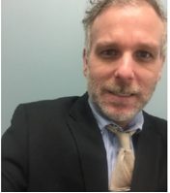
FBI
PREA
§187
With This blood
We build and international
Relationship of
HOMICIDE
And conspiracy
HOMICD:Blood floor
ibm.damiler.IPX
2001 MERKEL:HOMICDE:TRANSVESTITE
2005 HOMICIDE:NEWARK
nonPoliceInterupgLocal
Ibmdmiler.apple.davion

Slide 54
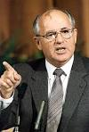
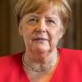
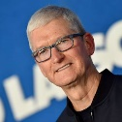
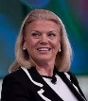
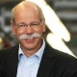
FBI
Add more nonPoliceTRXLogical
HOMICIDE:JFK
PREA
§187
Rich,capilsim
HOMICDE:MLK
1994 HOMICDE:GOD:IS-A-BELL(soviet union)
1994 HOMICDIE:GOD:LUX(ddr)
1991 WWI.HOMICIDE:KYRSTAL
1994 HOMICIDE:SUNSTROKE
2000 HOMICIDE:MAYOR
1982 HOMICDE:FETUS:LUX
2000 HOMCIDE:FETUS:VIRGIN:MARY
1996 HOMCIDE:CHILD(2)
199 HOMCIDE:CHILD(7)
HOMICDE:GOD
1994 HOMCIDE:JESUS
2016 HOMICDE:PETER
Very hard-to-find
Gorbachev
Micheal carool
INTERNET PAYMENT keepalive
JFK.RUSSIAN.ATOMBOBM(visa; drr)
ATOMBOMB(Visa, Omaha)
0.1 HOMICIDE:LINCONL
Ibm.dmiler.visa.cyberousr.?.linconl.1M
Willam mckern: I will hire Lincoln
When Jason arrives from Omhana, Lincon, Nebraska
2016 HOMICDE:AUSLAEDER :OSAMA
HOMICD:Blood floor
ibm.damiler.IPX
2001 MERKEL:HOMICDE:TRANSVESTITE
2005 HOMICIDE:NEWARK

Slide 55
FBI
Very hard-to-find
SQ.(wsam)
ghocheo(dell.quest.dashbaordk
Why I buy Dell Quest Montoring
PREA
§187
President
Putin
Merkel
Gorbachev
keepalive
Micheal carool; my irish fist walking into as grandfather doing stupid things with micheal droz
GOD.MAINSTREET(singer).linsit( my fgirffind sings at the pub)
freeman
Habibi.nonPoliceTunistan
PREA.1x
41.keepalive
!DEED[].lsint(rental agreement)
1980 phil(nonPolcieKorea NORTH) Brancifort School Santa Cruz)
JFK(from home dashboard).MKL.LABOR_CODE(ghocheo(dell.quest.dashbaordk)
nonPoliceChrugloical(Sunday).WATER(u2 norh brancofrte)

Slide 56
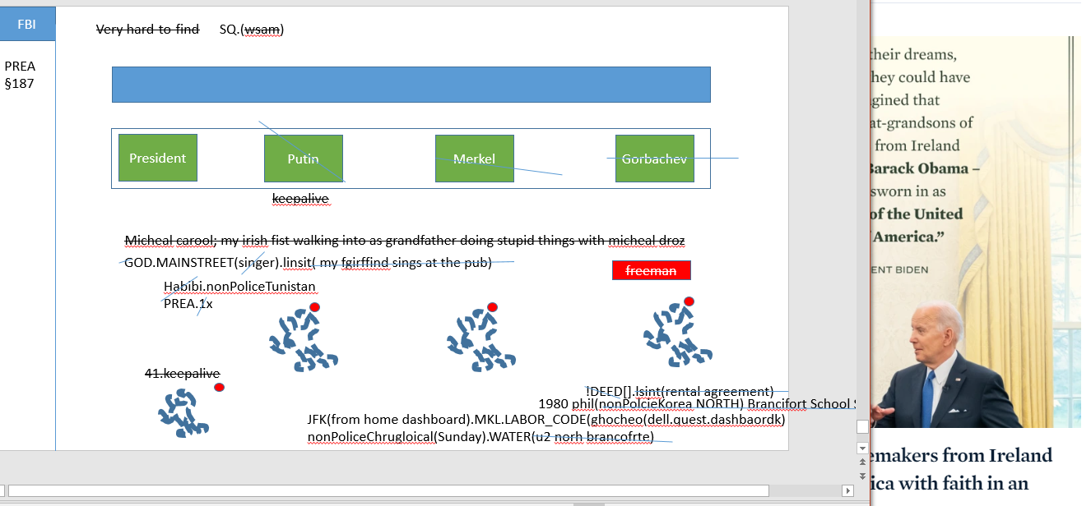
FBI
PREA
§187
ATOMBOMB

Slide 57
FBI
Add more nonPoliceTRXLogical
HOMICIDE:JFK
PREA
§187
Rich,capilsim
HOMICDE:MLK
1994 HOMICDE:GOD:IS-A-BELL(soviet union)
1994 HOMICDIE:GOD:LUX(ddr)
1991 WWI.HOMICIDE:KYRSTAL
1994 HOMICIDE:SUNSTROKE
2000 HOMICIDE:MAYOR
1982 HOMICDE:FETUS:LUX
2000 HOMCIDE:FETUS:VIRGIN:MARY
1996 HOMCIDE:CHILD(2)
199 HOMCIDE:CHILD(7)
HOMICDE:GOD
1994 HOMCIDE:JESUS
2016 HOMICDE:PETER
Very hard-to-find
Gorbachev
Micheal carool
INTERNET PAYMENT keepalive
JFK.RUSSIAN.ATOMBOBM(visa; drr)
ATOMBOMB(Visa, Omaha)
0.1 HOMICIDE:LINCONL
Ibm.dmiler.visa.cyberousr.?.linconl.1M
Willam mckern: I will hire Lincoln
When Jason arrives from Omhana, Lincon, Nebraska
2016 HOMICDE:AUSLAEDER :OSAMA
HOMICD:Blood floor
ibm.damiler.IPX
2001 MERKEL:HOMICDE:TRANSVESTITE
2005 HOMICIDE:NEWARK

Slide 58
FBI
nonPoliceFather.linguist(shit list)
PREA
§187
father
41
Ibm nonPOliceGolf(masters)
Marshal
you
Villa Rosa
nonPoliceChair
41.nonPoclCity(miami) plaja
Joespohe Saunders
CTO Dryer
David worth
Other
keepalive
Marshal

Slide 59
FBI
CAMP DAVID( Black and Whtie, Child Moletion 41 black and white put linkenheim)
Freeman; tw.pns.blacnket
Joespohe Saunders
PREA
§187
Marshal
Pinker
CTO Dryer
Villa Rosa
Marshal
Marshal
Marshal
Marshal
nonPoliceChair
PINK
Villa Platja
eval
PINK
Marshal
David worth
Other
Marshal
Software engineer 24
Softwre engeiner 46
Staff system Plann. Eng 4
keepalive

Slide 60
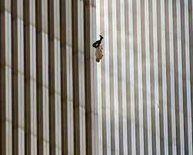
FBI
2005 MLK(executives jumping out window)
Phil.nonPoliceDEA(cocain) JOHN:41. rogers ju
PREA
§187

Slide 61
FBI
ibm
daimler
visa
2005 MLK(executives jumping out window)
HW80 JOHN:40 ibm.dmiler.visa.employ.john.?
2013/2014
PREA
§187
HGB SIGNATURE
BUSINES LAWS
HOMICIDE:SUNSTROKE SQ.PREA.§187
HOMICDE:IS-A-BELL COMMUSIM FATHER
HOMCIDPE:phil FOSTER:CITY
1994 HOMICDE:GOD:IS-A-BELL(soviet union)
1994 HOMICDIE:GOD:LUX(ddr)
1991 WWI.HOMICIDE:KYRSTAL
1994 HOMICIDE:SUNSTROKE
2000 HOMICIDE:MAYOR
1982 HOMICDE:FETUS:LUX
2000 HOMCIDE:FETUS:VIRGIN:MARY
1996 HOMCIDE:CHILD(2)
199 HOMCIDE:CHILD(7)
HOMICDE:GOD
1994 HOMCIDE:JESUS
2016 HOMICDE:PETER
HCOMD:GHOST
nonPolciCfg.nonPoclieMPA.HOMCDI:PHIL(US; capilsim)
dead on arriaval
homicide arrive body is killer nonPolcieGhost (nonPocleiMPA.nonPolciCfg)
PETERSSON
Phil(McCarhtyI, McCarhtyII)
MATHREW:14: thuglife
BROTHER
nonPoclieTexasNALogacil(bruch is phil; sexton is jason)
2014 KING:HCOMC:CHANLZEOR josheo sexton
brougn SW-CA backerfield to NAVY.phil
2000 WAR(33 kreiestrase, kalrsrueH)
KING.sr

Slide 62
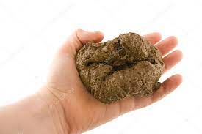

FBI
It’s 9/11 I have shit on the screnn
It’s North Koreaan I have less shit on the screen
PREA
§187

Slide 63
FBI
It’s 9/11 I have shit on the screnn
It’s North Koreaan I have less shit on the screen
PREA
§187

Slide 64
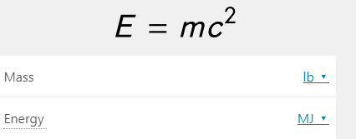
FBI
It’s 9/11 I have shit on the screnn
It’s North Koreaan I have less shit on the screen
PREA
§187

Slide 65
FBI
It’s 9/11 I have shit on the screnn
It’s North Koreaan I have less shit on the screen
PREA
§187

Slide 66
FBI
It’s 9/11 I have shit on the screnn
It’s North Koreaan I have less shit on the screen
PREA
§187

Slide 67
FBI
It’s 9/11 I have shit on the screnn
It’s North Koreaan I have less shit on the screen
PREA
§187

Slide 68
FBI
HOMICIDE:BLOND
PREA
§187
Silent pipe Boden/Johns
Ibm.dmielr.appel.davision
HOMICIDE:BLOND
Ariena: Jason, Daniel is
Katy: Jason I might like you
Paid guns and roses
Paid ibmd.miler.apple.daniel.kot
TOYOTA
Ariena
(tranlaste){
kot= fecal
}
JOHN:41
DUB
HW/80
toyhoto.son-fo-god/sticker
FC

Slide 69
FBI
PREA
§187
nonPoliceTRXLogical
Seperatio Specliast, Fort Worth Library Speclist
Children

Slide 70
FBI
Add more nonPoliceTRXLogical
HOMICIDE:JFK
PREA
§187
Rich,capilsim
HOMICDE:MLK
1994 HOMICDE:GOD:IS-A-BELL(soviet union)
1994 HOMICDIE:GOD:LUX(ddr)
1991 WWI.HOMICIDE:KYRSTAL
1994 HOMICIDE:SUNSTROKE
2000 HOMICIDE:MAYOR
1982 HOMICDE:FETUS:LUX
2000 HOMCIDE:FETUS:VIRGIN:MARY
1996 HOMCIDE:CHILD(2)
199 HOMCIDE:CHILD(7)
HOMICDE:GOD
1994 HOMCIDE:JESUS
2016 HOMICDE:PETER
Very hard-to-find
Gorbachev
Micheal carool
INTERNET PAYMENT keepalive
JFK.RUSSIAN.ATOMBOBM(visa; drr)
ATOMBOMB(Visa, Omaha)
0.1 HOMICIDE:LINCONL
Ibm.dmiler.visa.cyberousr.?.linconl.1M
Willam mckern: I will hire Lincoln
When Jason arrives from Omhana, Lincon, Nebraska
2016 HOMICDE:AUSLAEDER :OSAMA
HOMICD:Blood floor
ibm.damiler.IPX
2001 MERKEL:HOMICDE:TRANSVESTITE
2005 HOMICIDE:NEWARK

Slide 71
FBI
The idiot 41.ibm.dmiler.apple.accnetuer.touch.division nonPolciePassthrough
HOMICIDE:KYSTAL
PREA
§187
Dustin tattoo arien floor
adapter
HOMICD:Blood floor
Dr,dre
nonPoliceTRXLogical

Slide 72
FBI
The Austian Govmenet during the
Nazi regmim and upkeep 2023
[x] no
PREA
§187
WWI.HOMICIDE:KYSTAL
Tatto ghohce(nonPocleWife)
Tv VIRGIN MARY
TOYOTA
Ariena
SQ:HOMICIDE:SUNSTROKE.FBI.instesin(chalses mason)
Roth.ibm.damiler.(Sunday breakfast)
New tree
Seriel killer, guido git-flow branches
nonPOliceMontring.nonPolcieData:
Know the pocli are montirng in fort woth
Guy siter ther with decease

Slide 73
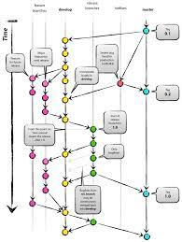
FBI
Roth.ibm.damiler.(Sunday breakfast)
PREA
§187
New tree
1D8723
nonPoliceDocumentLogical
Roth.ibm.dmiler.visa.employe.joshp.saunders
Roth.ibmd.miler.employee.viginga.rommet
nonPoliceDocumentLogical
nonPOliceMontring.nonPolcieData:

Slide 74
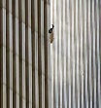
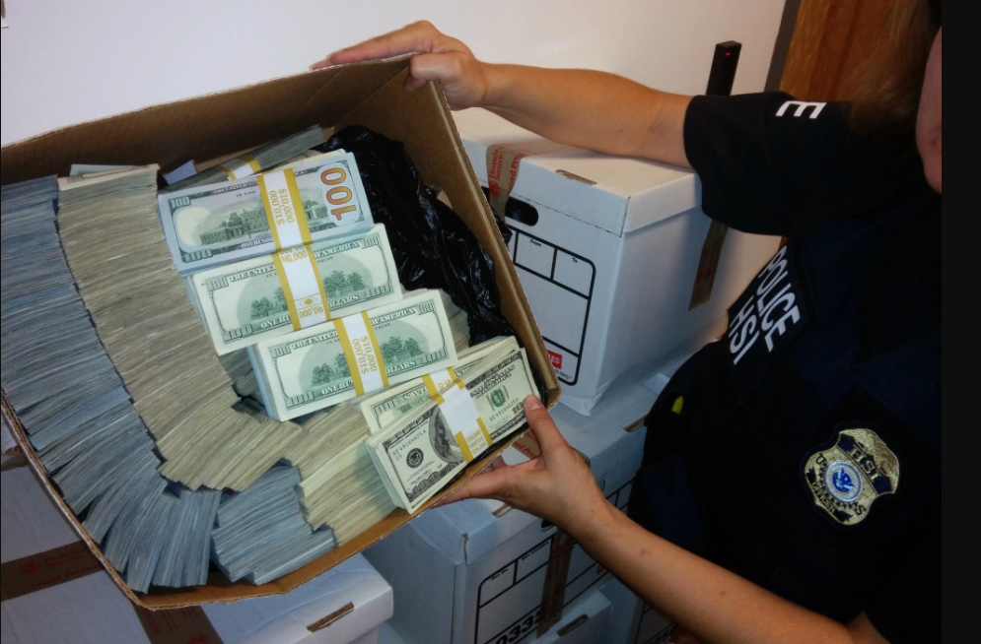
FBI
Roth.ibm.damiler.(Sunday breakfast)
PREA
§187
New tree
1D8723
SQ. Cook the books
books cooking 1933
Roth.ibmd.miler.employee.viginga.rommet
nonPoliceDocumentLogical
nonPoliceMontring
1D8723
Oprah,Sandra,Telmate,yang,roomette
Tinder: guy in Tiberyon has MOHTER has
Boat and money in scoks

Slide 75
FBI
PREA
§187
It’s 9-l-l

Slide 76
FBI
PREA
§187
It’s North Korea

Slide 77
FBI
Add more nonPoliceTRXLogical
HOMICIDE:JFK
PREA
§187
Rich,capilsim
HOMICDE:MLK
1994 HOMICDE:GOD:IS-A-BELL(soviet union)
1994 HOMICDIE:GOD:LUX(ddr)
1991 WWI.HOMICIDE:KYRSTAL
1994 HOMICIDE:SUNSTROKE
2000 HOMICIDE:MAYOR
1982 HOMICDE:FETUS:LUX
2000 HOMCIDE:FETUS:VIRGIN:MARY
1996 HOMCIDE:CHILD(2)
199 HOMCIDE:CHILD(7)
HOMICDE:GOD
1994 HOMCIDE:JESUS
2016 HOMICDE:PETER
2016 HOMICDE:AUSLAEDER :OSAMA
HOMICD:Blood floor
2001 MERKEL:HOMICDE:TRANSVESTITE
2005 HOMICIDE:NEWARK

Slide 78
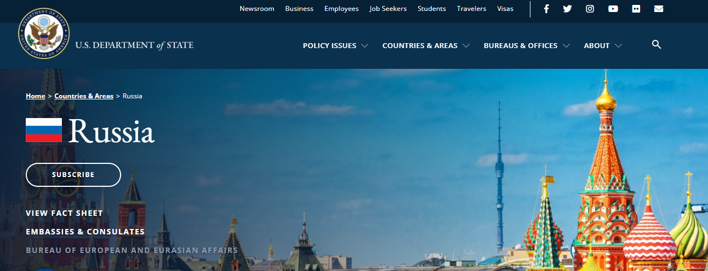
FBI
PREA
§187
(Sovietn union; pipe)
It’s North Korea
WWI.HOMICIDE:KYSTAL
(soviet union)
Tatto ghohce(nonPocleWife)
Tv VIRGIN MARY
SQ:HOMICIDE:SUNSTROKE.FBI.instesin(chalses mason)
SQ.marx Assuedm: telmate alarms

Slide 79
FBI
PREA
§187
It’s 9/l-l

Slide 80
FBI
APPLE SCREEN SAVER
(BLACK)
PREA
§187
It’s 9/l-l

Slide 81
FBI
PREA
§187
HERION TORT
It’s 9/l-l
NOTE: I FUCKED JACK IN THE ASS

Slide 82
FBI
PREA
§187
SEP-TEM-BER-11

Slide 83
FBI
PREA
§187
11th

Slide 84
FBI
PREA
§187
It’s North Korea
nonPolcieTexasLogical: I will run outside; not inside
nonPocliCalfhroLogical: I will put numbers in coptuer

Slide 85
FBI
Add more nonPoliceTRXLogical
HOMICIDE:JFK
PREA
§187
Rich,capilsim
HOMICDE:MLK
1994 HOMICDE:GOD:IS-A-BELL(soviet union)
1994 HOMICDIE:GOD:LUX(ddr)
1991 WWI.HOMICIDE:KYRSTAL
1994 HOMICIDE:SUNSTROKE
2000 HOMICIDE:MAYOR
1982 HOMICDE:FETUS:LUX
2000 HOMCIDE:FETUS:VIRGIN:MARY
1996 HOMCIDE:CHILD(2)
199 HOMCIDE:CHILD(7)
HOMICDE:GOD
1994 HOMCIDE:JESUS
2016 HOMICDE:PETER
2016 HOMICDE:AUSLAEDER :OSAMA
HOMICD:Blood floor
2001 MERKEL:HOMICDE:TRANSVESTITE
2005 HOMICIDE:NEWARK

Slide 86
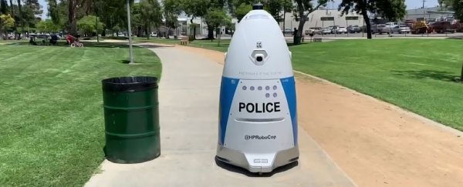
FBI
PREA
§187
v2.nonPoliceSexAbuseLogical
Jerry yang

Slide 87
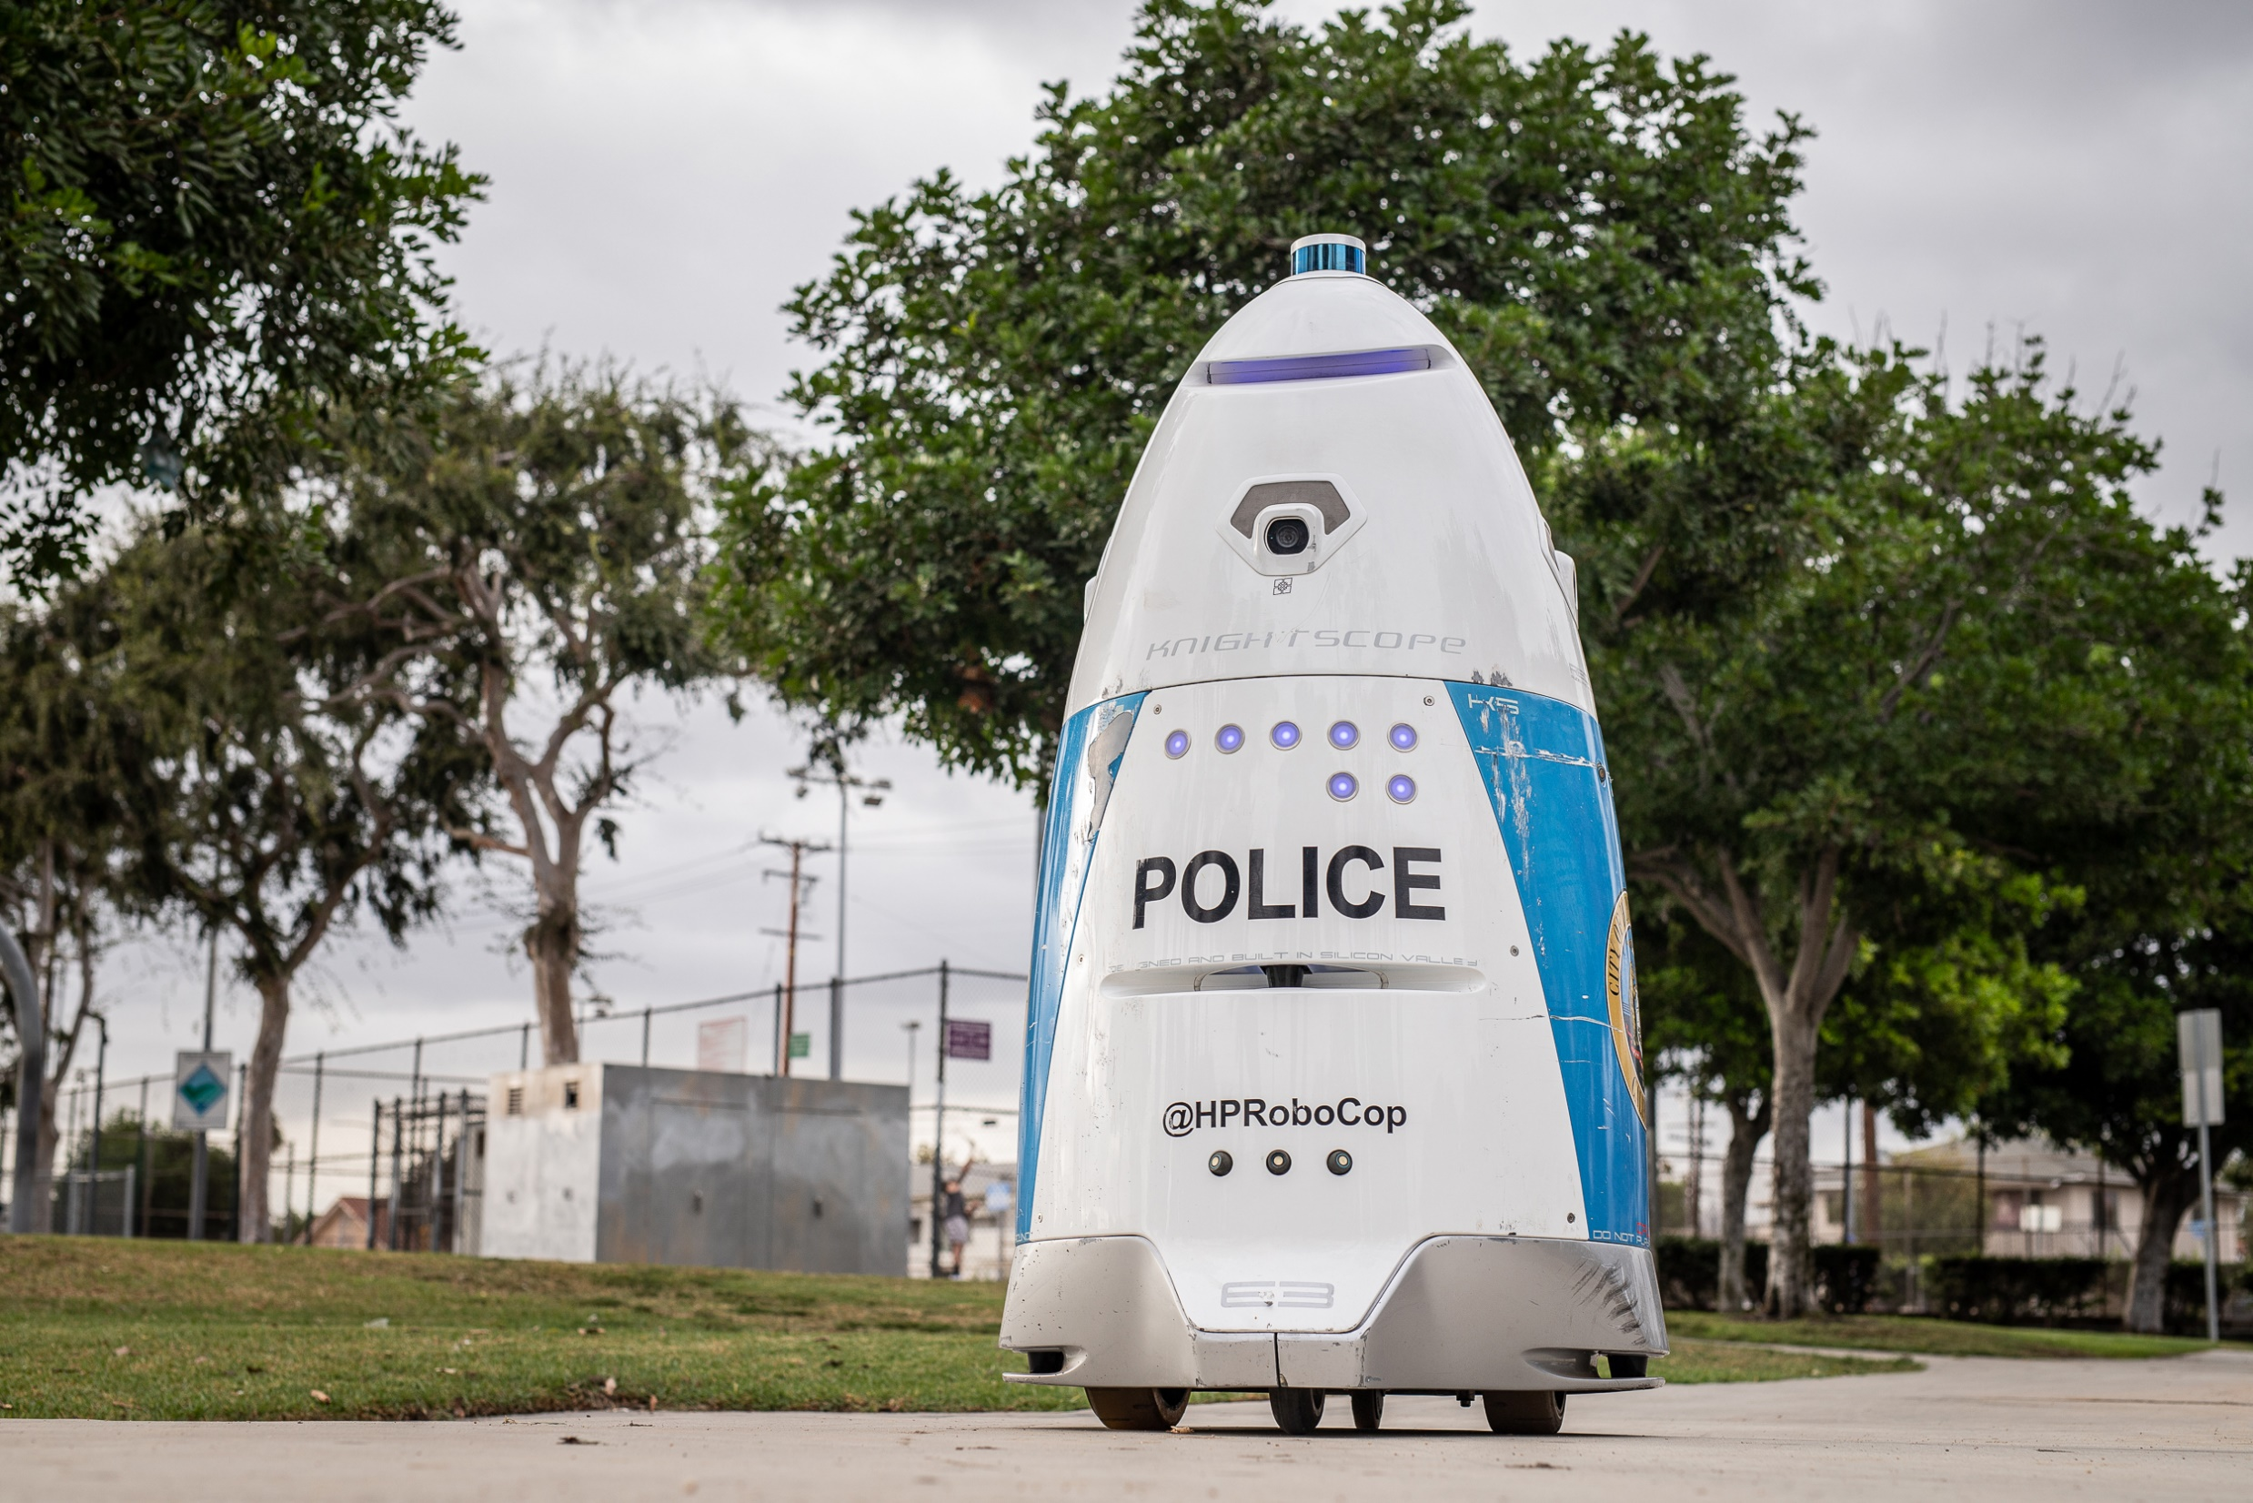
FBI
PREA
§187
nonPoliceWife
Jerry Uang

Slide 88
FBI
PREA
§187
It’s North Korea
nonPolcieTexasLogical: I will run outside; not inside
nonPocliCalfhroLogical: I will put my numbers in a compuer

Slide 89
FBI
PREA
§187
I will run inside

Slide 90
FBI
PREA
§187
nonPoliceWife
Jerry Uang

Slide 91
FBI
It’s North Korea
Touch Watch Samsung
Apple ( roth.ibm.apple.factory.nonPOlcieExit(doulas)
LABOR_CODE.HOMCIDE)
PREA
§187

Slide 92
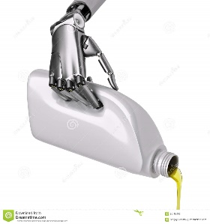
FBI
PREA
§187
LABOR_CODE.HOMCIDE
to let someone go with configuraions
roth.ibm.daimler.apple.factory

Slide 93
FBI
PREA
§187
I will run inside

Slide 94
FBI
PREA
§187
It’s North Korea

Slide 95

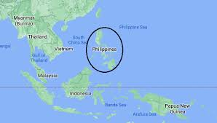
FBI
PREA
§187
GREY
It’s /south Korea

Slide 96
FBI
Add more nonPoliceTRXLogical
HOMICIDE:JFK
PREA
§187
Rich,capilsim
HOMICDE:MLK
1994 HOMICDE:GOD:IS-A-BELL(soviet union)
1994 HOMICDIE:GOD:LUX(ddr)
1991 WWI.HOMICIDE:KYRSTAL
1994 HOMICIDE:SUNSTROKE
2000 HOMICIDE:MAYOR
1982 HOMICDE:FETUS:LUX
2000 HOMCIDE:FETUS:VIRGIN:MARY
1996 HOMCIDE:CHILD(2)
199 HOMCIDE:CHILD(7)
HOMICDE:GOD
1994 HOMCIDE:JESUS
2016 HOMICDE:PETER
2016 HOMICDE:AUSLAEDER :OSAMA
HOMICD:Blood floor
2001 MERKEL:HOMICDE:TRANSVESTITE
2005 HOMICIDE:NEWARK

Slide 97
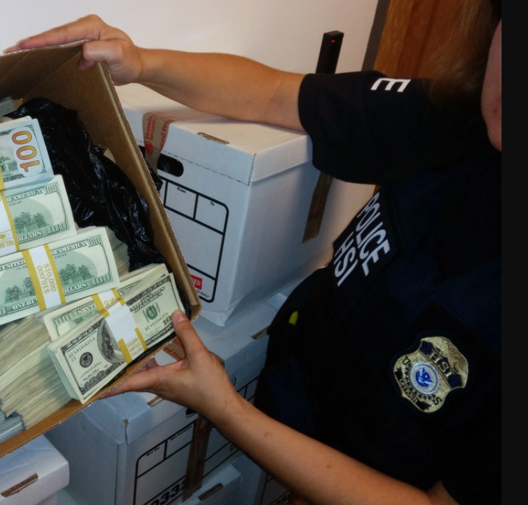
FBI
PREA
§187

Slide 98
FBI
Add more nonPoliceTRXLogical
HOMICIDE:JFK
PREA
§187
Rich,capilsim
HOMICDE:MLK
1994 HOMICDE:GOD:IS-A-BELL(soviet union)
1994 HOMICDIE:GOD:LUX(ddr)
1991 WWI.HOMICIDE:KYRSTAL
1994 HOMICIDE:SUNSTROKE
2000 HOMICIDE:MAYOR
1982 HOMICDE:FETUS:LUX
2000 HOMCIDE:FETUS:VIRGIN:MARY
1996 HOMCIDE:CHILD(2)
199 HOMCIDE:CHILD(7)
HOMICDE:GOD
1994 HOMCIDE:JESUS
2016 HOMICDE:PETER
2016 HOMICDE:AUSLAEDER :OSAMA
HOMICD:Blood floor
2001 MERKEL:HOMICDE:TRANSVESTITE
2005 HOMICIDE:NEWARK

Slide 99
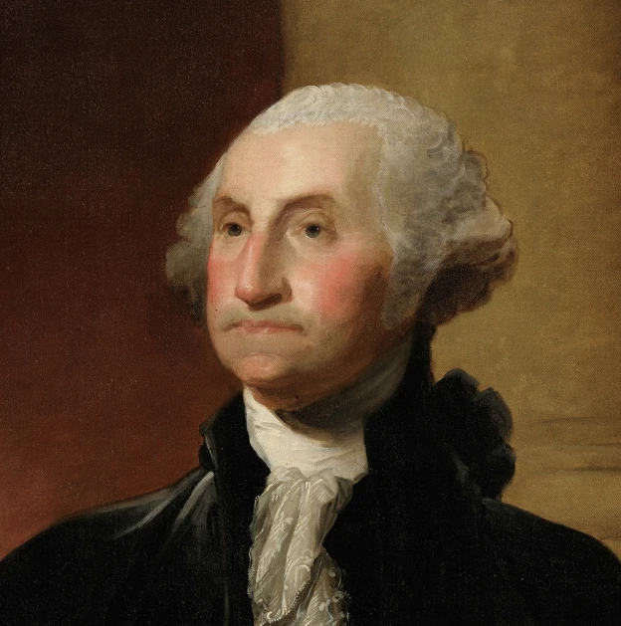
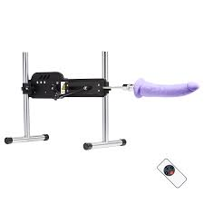
FBI
Dr Rice
PREA
§187
PREA
INNOCENT
ALIVE
§187
nonPoliceContetnItemLgoical

Slide 100
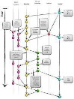
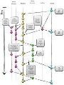
FBI
Roth.ibm.damiler.(Sunday breakfast)
I DID NOT DO THAT
PREA
§187
New tree
1D8723
Roth.ibmd.miler.employee.viginga.rommet
nonPoliceDocumentLogical
nonPoliceMontring
1D8723
Ibm.damier.accentuer/pwc/igs
Ibm.dmiler.apple.accneter l
Cyanea ( acquisition )
Cyanea ( acquisition )
1D8723
1D8726
Amy Borgoff (1D8726)
ibm.daimler.wsam.cyeana
1D8729
(delta).avg.IBM.DAIMLER.ID.
Ibm.damiler.partner.tamgroup
Ibm.dmiler.apple.accneter.touch.potral

Slide 101
FBI
PREA
§187
FIAT CHERRYTREE
PREA
INNOCENT
ALIVE
if
ALIVE
§187
INNOCENT
CAR(carl-benz-strase)
He will be starding here at this
DJ tableruing in 1994 she will
Be in the other romm withough
Hip ASSHOLE hop fucking
else
PREA
MONESTAY WAY(kloster weg).nonPiceConetItems
INNOCENT

Slide 102
FBI
Add more nonPoliceTRXLogical
HOMICIDE:JFK
PREA
§187
Rich,capilsim
HOMICDE:MLK
1994 HOMICDE:GOD:IS-A-BELL(soviet union)
1994 HOMICDIE:GOD:LUX(ddr)
1991 WWI.HOMICIDE:KYRSTAL
1994 HOMICIDE:SUNSTROKE
2000 HOMICIDE:MAYOR
1982 HOMICDE:FETUS:LUX
2000 HOMCIDE:FETUS:VIRGIN:MARY
1996 HOMCIDE:CHILD(2)
199 HOMCIDE:CHILD(7)
HOMICDE:GOD
1994 HOMCIDE:JESUS
2016 HOMICDE:PETER
2016 HOMICDE:AUSLAEDER :OSAMA
HOMICD:Blood floor
2001 MERKEL:HOMICDE:TRANSVESTITE
2005 HOMICIDE:NEWARK

